Slide 1

Offline AI SOS Mesh Network
Resilient Emergency Signaling for Barbados

Slide 2
The Problem
Hurricanes & outages can knock out cellular/fibre networks.
Citizens lose reliable channels to request help.
Response teams struggle to locate and prioritise emergencies.

Slide 3
Our Solution
Self‑healing phone‑to‑phone mesh via ESP8266 nodes.
Edge‑AI ranks the best hop path, filtering noise.
SOS packets reach the nearest gateway, then emergency response.

Slide 4
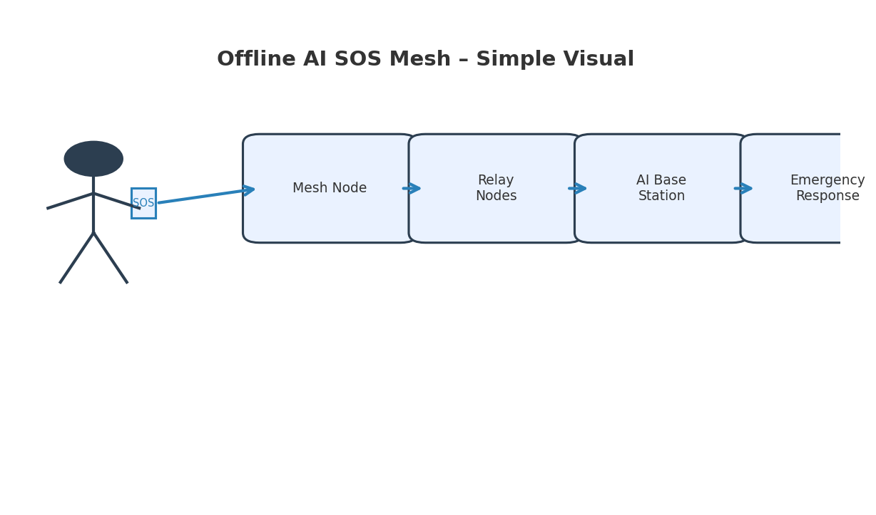
High‑Level Flow
Tap SOS → Mesh Node → Relay Nodes → AI Base → Emergency Response

Slide 5

Product Concept – Node Hardware
ESP8266 MCU + ESP‑NOW / Wi‑Fi Direct Or Raspberry pi 5
Li‑ion battery + solar trickle charge
Built‑in RGB LED: status & battery
Oled Display w/ buttons for locally run ai query data
Transceivers for greater bandwitdth
Custom pcb w/ sensors ( humidty, temperature, altitude,
Cost target: < US$25 per node

Slide 6

Prototype illustration

Slide 7

Central Node Illustration

Slide 8
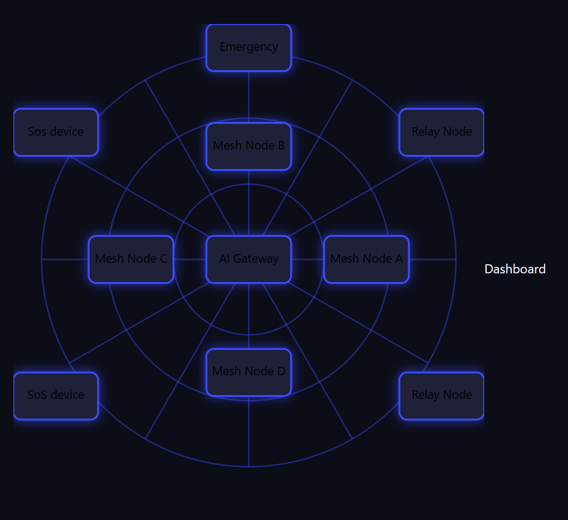
Web-system diagram

Slide 9

Impact & Metrics
Pilot: 20 nodes in rural parishes
Delivery success ≥ 95% over 3 hops
Median SOS latency < 15 s
Island‑wide latency heat‑map dashboards

Slide 10
Roadmap & Ask
P0 (1 month) – Lab prototype & demo
P1 (3 months) – Field pilot, 20 nodes
P2 (6 months) – Island roll‑out & university sponsorship
Seed funding: BBD $75k + cloud credits + gateway access

